Slide 1


BVRIT HYDERABAD College of Engineering for Women Department of Computer Science and Engineering
Precipitation runoff prediction
Under the guidance of:
Name: Mr. C. Nagaraju
Designation: Assistant professor
Team No: B15
K. Sai Sharanya: 19wh1a0570
I. Lakshmi Apoorva: 19wh1a05a8
M. Vaishanavi: 19wh1a0569

Slide 2
AGENDA
Introduction
Existing system
Problem statement
Literature Survey
Proposed system
Tools and Technology
Architecture
Methodology
Dataset
Evaluation Metrics
Result
Demo
Societal impact
References

Slide 3
INTRODUCTION
Rainfall information in the past helps farmers better manage their crops, leading to economic growth in the country. The achievement of agriculture is dependent on rainfall. It also helps with water resources. Prediction of precipitation is beneficial to prevent flooding that saves people's lives and property.
Fluctuation in the timing of precipitation and its amount makes forecasting of rainfall a problem for meteorological scientists.
To overcome these problems, a machine learning technology is used which is predictive analysis that is a branch of data mining which predicts the future probabilities and trends.
Prediction is the phenomenon of knowing what may happen to a system in the near future. Since rainfall is the major causes of calamities like floods and typhoons, predicting the occurrence of rainfall will help us to be prepared for these calamities.

Slide 4
INTRODUCTION cont..
Even though many models have developed, it is necessary for doing research using machine learning algorithms to get accurate predictions.
The error free prediction provides better planning in the agriculture and other industries, Henceforth we will use the CatBoost model for faster and accurate prediction .
Also, By using random forest machine learning model and we get out required output . Random forest method is excellent for light rain predictions as it gives the best accuracy. It also performs well for the no rain, moderate rain, and for light rain.
We also use Support Vector Machines (SVM) which are popularly and widely used for classification problems in machine learning.

Slide 5
EXISTING SYSTEM
Existing system depended on a system called numerical weather prediction . That method uses “the latest weather observations alongside a mathematical computer model of the atmosphere” to make forecasts.
If we observe the previous existing projects of precipitation predictions they had considered the data-sets which belongs to the average precipitation of months based on year-wise data.
They had predicted the average precipitation of upcoming months and they faced few errors like RMSE , MSE .

Slide 6
PROBLEM STATEMENT
Precipitation prediction is a cause for natural disasters like flood and drought which are encountered by people across the globe every year. Precipitation Prediction is the application of science and technology to predict the amount of Precipitation over a region.
It is important to exactly determine the Precipitation for effective use of water resources, crop productivity and pre-planning of water structures.

Slide 7
LITERATURE SURVEY
S.No | Title of the paper | Author(s) & Journal Details | Description/ Interpretation
1. | Support vector machine regressor | Debasish Basak, Srimanta Pal, Dipak Chandra Patranabis | Support Vector Regression is a supervised learning algorithm that is used to predict discrete values. The basic idea behind SVR is to find the best fit line. In SVR, the best fit line is the hyperplane that has the maximum number of points.
2. | Rainfall prediction using Extreme Gradient Boosting- Catboost | M T Anwar1, E Winarno1, W Hadikurniawati1 and M Novita2 | CatBoost or Categorical Boosting is an open-source boosting library developed by Yandex. In addition to regression and classification, CatBoost can be used in ranking, recommendation systems, forecasting and even personal assistants.
3. | Weather prediction using Random forest machine learning Model | R. Meenal1, Prawin Angel Michael2, D. Pamela3, E. Rajasekaran4 | This study neglects the need for an expensive measuring instrument in all potential locations to acquire the solar radiation and wind speed data.

Slide 8
PROPOSED SYSTEM
In this project by considering the Austin weather dataset, predicted average rainfall based on the climatic parameters like Humidity, Dew Point, Sea Level Pressure, Visibility Miles and Precipitation Inches. By using this, we can predict average Rainfall with more accuracy compared to other algorithms.
Several techniques such as linear Random forest, cat boost models and SVR have to be employed to identify the best parameters for precipitation prediction.

Slide 9
TOOLS AND TECHNOLOGIES
Python3
Libraries
Pandas
NumPy
Matplotlib
Sklearn

Slide 10
ARCHITECTURE
Precipitation prediction models
-CAT boost
Random Forest
Support Vector machine regressor
Model evaluation
Actual observed data
Evaluation metrics
Forecasted precipitation data
Dataset
Data pre-processing
& Feature selection

Slide 11
METHODOLOGY
Random forest - Random forest is a tree based model, it is a collection of many tree models. Different tuning parameters are used for tuning the model. Random forest method is excellent for light rain predictions as it gives the best accuracy. It also performs well for the no rain, moderate rain, and for light rain. In random forest one of the parameters shows exactly how many trees should be more used to get the accurate results. Random forest works really well with high variant and low biasing models. It is observed that after 250 number trees error rate doesn’t change. Hence 250 number of trees are restricted to in the forest. Random forest method is excellent for light rain predictions as it gives the best accuracy. It also performs well for the no rain, moderate rain, and for light rain.
CATBoost - CatBoost builds upon gradient boosted decision trees including a training dataset, with accuracy determined on a validation dataset. In training, those decision trees are built consecutively with each tree having its loss reduced. This model follows a technique that is additionally divided into four parts: (a) data pre-processing that involves the gathering of pollutants and other alternative meteorological data alongside with correction of missing values; (b) analysis associated with relationship between meteorological parameters or variables which of the pollutants; (c) feature importance involves the screening of meteorological parameters and conjoints the pollutants in air right before the operation on the models; (d) the application of models like catboost.
17/03/2023

Slide 12
METHODOLOGY
SVR(Support Vector Machine Regressor)- Accurate forecasting of rainfall has been one of the most important issues in hydrological research. Here, a novel neural network technique, support vector regression (SVR), to monthly rainfall forecasting. The aim of this study is to examine the feasibility of SVRin monthly rainfall forecasting by comparing it with back–propagation neural networks (BPNN) and the autoregressive integrated moving average (ARIMA) model. SVR acknowledges the presence of non-linearity in the data and provides a proficient prediction model.

Slide 13
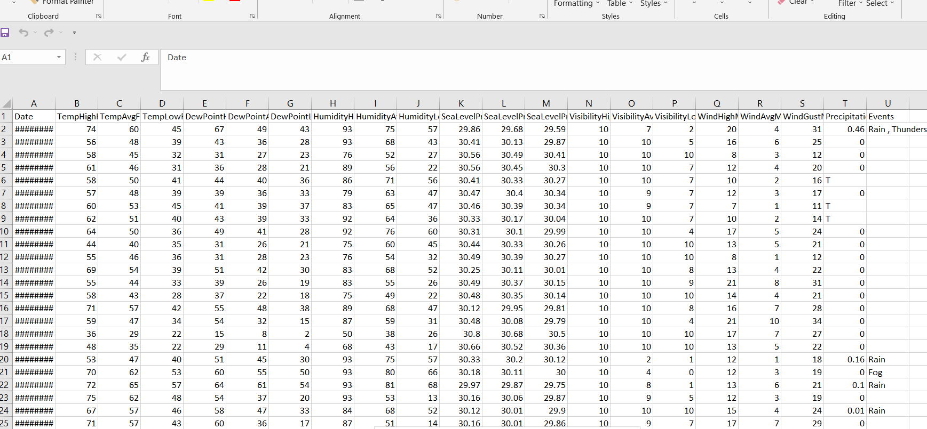
DATASET

Slide 14
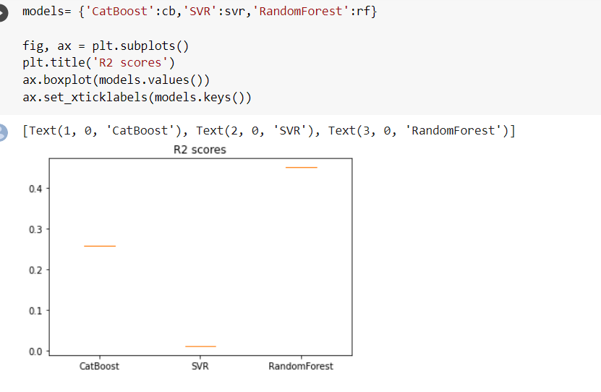
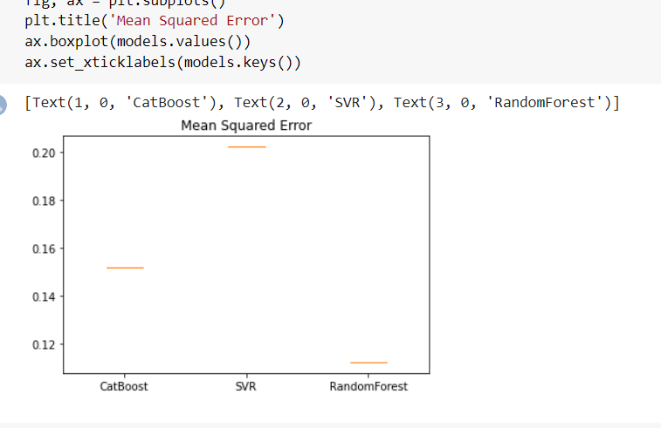
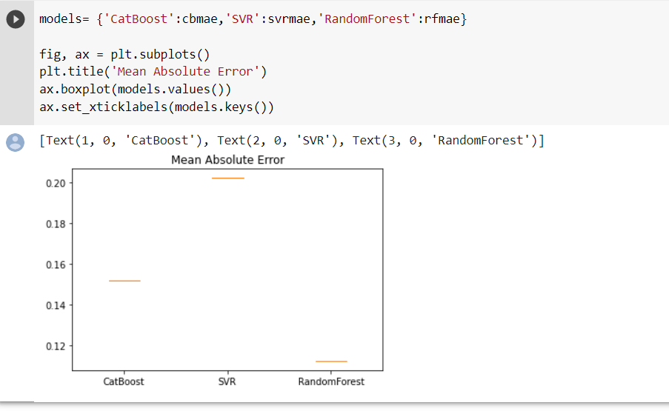
EVALUATION METRICS

Slide 15
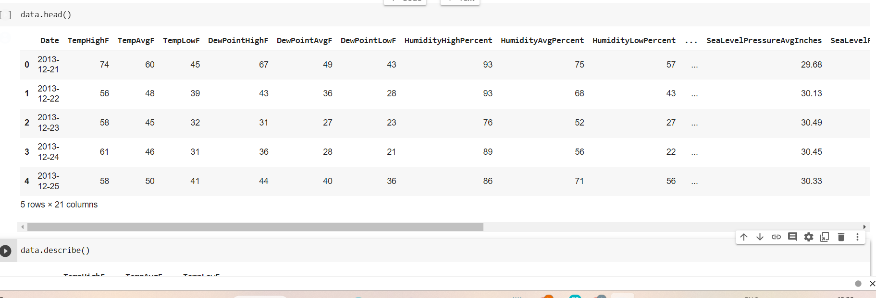
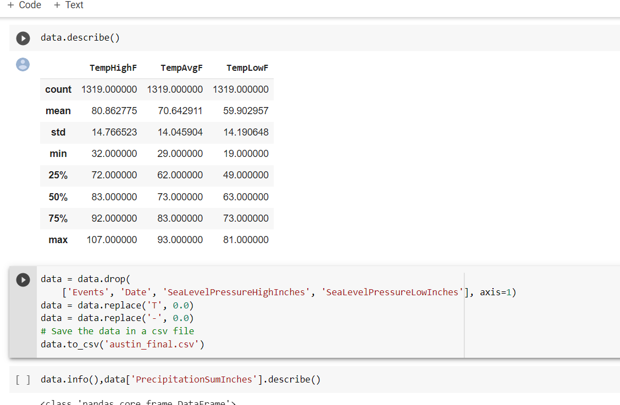
RESULT

Slide 16
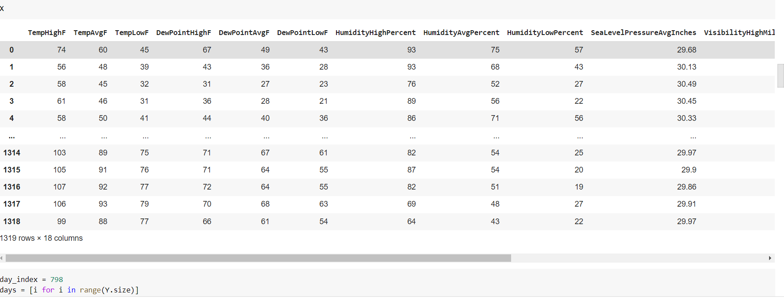
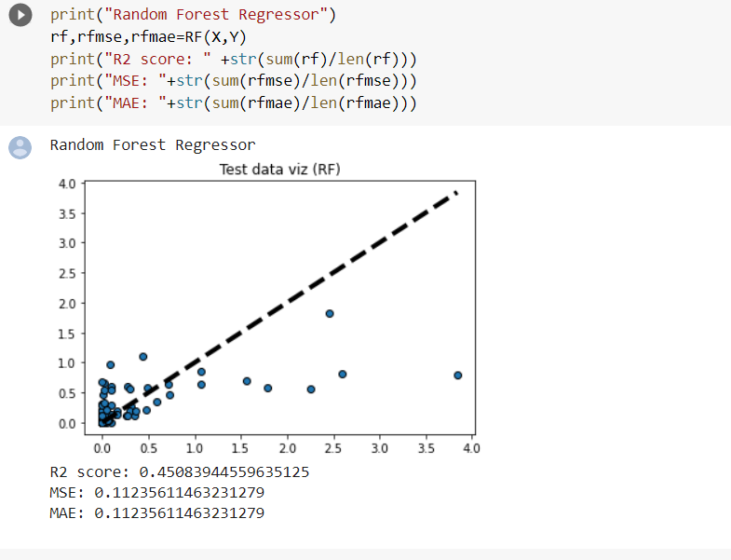

Slide 17
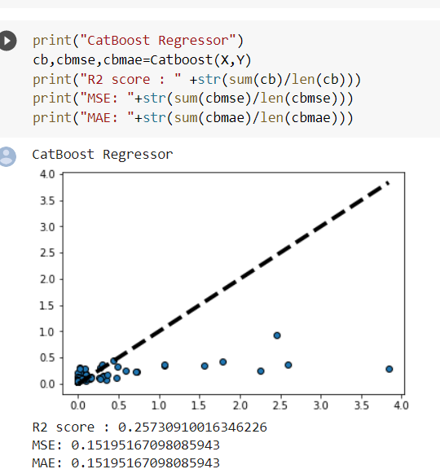
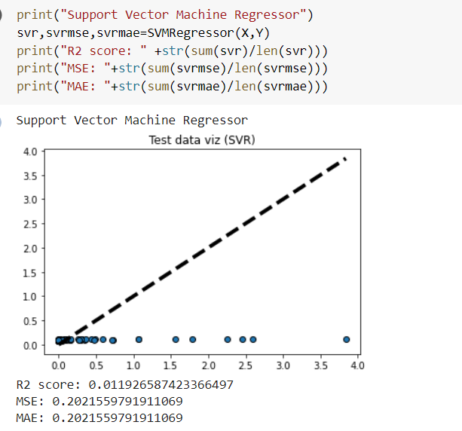

Slide 18
DEMO

Slide 19
SOCIETAL IMPACT
Machine learning techniques are increasingly being used in precipitation prediction and visualization to offer prescient knowledge
The estimation of precipitation is of great importance in terms of water resources management, human life and their environment.
Rainfall forecasting is very important because heavy and irregular rainfall can have many impacts like destruction of crops and farms, damage of property so a better forecasting model is essential for an early warning that can minimize risks to life and property and also managing the agricultural farms in better way.
17/03/2023

Slide 20
CONCLUSION
In our project we have collected the information and after a thorough study we have designed a necessary architecture suitable for our project-”Precipitation run off prediction”
In this work we have imported required libraries like NumPy, pandas, matplotlib and after collecting the data from our data set we have preprocessed it and finally obtained the required result of our precipitation runoff prediction.

Slide 21
REFERENCES
[1] Lee, Yuh-Jye, Wen-Feng Hsieh, and Chien-Ming Huang. “e-SSVR: A Smooth Support Vector Machine for
e-Insensitive Regression.” IEEE Transactions on Knowledge and Data Engineering 17, no. 5 (2005): 678–685.
[2] Anwar, M.T., Winarno, E., Hadikurniawati, W. and Novita, M., 2021, April. Rainfall prediction using Extreme Gradient Boosting. In Journal of Physics: Conference Series (Vol. 1869, No. 1, p. 012078). IOP Publishing.
[3] Meenal, R., Michael, P.A., Pamela, D. and Rajasekaran, E., 2021. Weather prediction using random forest machine learning model. Indonesian Journal of Electrical Engineering and Computer Science, 22(2), pp.1208-1215.
[4] Vijithra Nair, Megha Mathew, Sweta Bhattacharjee, Arashdip Singh, Prof. Payel Thakur,2021. Survey on Rain Prediction using Machine Learning. International Research Journal of Engineering and Technology (IRJET), Volume: 08 Issue: 12

Slide 22
THANK YOU

